Slide 1
Intro to Unit Testing
Ian Philpot and Josh Lane

Slide 2
Simple demo
Notes:
Functional library under test
Unit test definitions
Test runner
Test cases

Slide 3
Types of testing
Unit
Focused on a discrete, atomic code artifact
Integration
Focused on external dependency interactions (typically out-of-proc)
Typically one dependency at a time (or perhaps a few related ones)
System (aka end-to-end)
Focused on overall system behavior (perf, scale, resilience, )
Does the system function without error?
Acceptance
Focused on end user experience
Does the system meet or exceed user expectations?

Slide 4
“Unit tests are low-level, focusing on a small part of the software system… [they] are usually written by the programmers themselves using their regular tools… [they] are expected to be significantly faster than other kinds of tests.” - Martin Fowler

Slide 5
Goals and Consequences
Reduce defects (duh!)
Aligns with modern notions of process automation
Testability → “good design”
Intentional vs. accidental design
SOLID
Tangible (though insufficient ☺) indicator of software quality
More confident adaptation to downstream changes

Slide 6
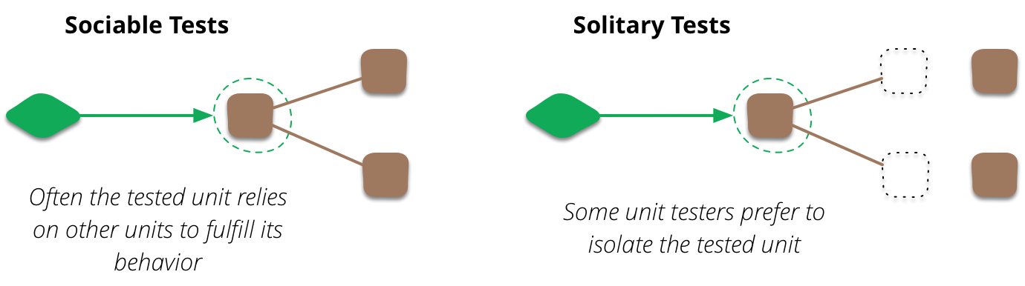
To Mock, Or Not To Mock

Slide 7
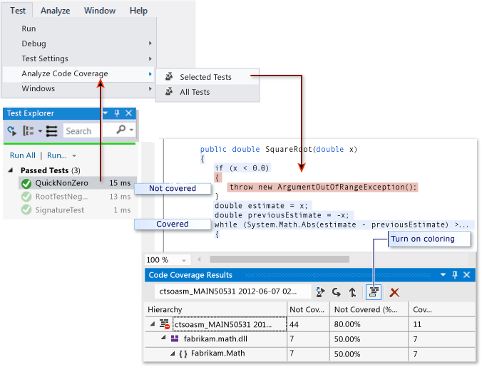
Code Coverage

Slide 8
Advanced demo
Notes:
Code coverage
Mocking (facilitated by abstraction)

Slide 9
Trouble spots
“We don’t have time for tests”
…only if you consider tests a distinct (optional) artifact
“We don’t have time to update/fix tests”
Broken tests are tech debt
Disabled tests are tech debt
“Our tests take too long to run”
Use mocks
Reconsider your definition of “unit”
Refactor your CI/CD pipeline
“All class methods have to be public”
Focus on validating observable behavior vs. merely testing methods or classes

Slide 10
More info
https://martinfowler.com/bliki/UnitTest.html
https://en.wikipedia.org/wiki/Unit_testing
https://en.wikipedia.org/wiki/SOLID
https://docs.microsoft.com/en-us/dotnet/core/testing/unit-testing-with-mstest
https://mochajs.org/
http://www.chaijs.com/

